Slide 1
FIFA WORLD CUP ANALYSIS
BY,
VAISHALI KHANDELWAL
EMAIL ID: VAISHALI.KH2310@GMAIL.COM

Slide 2

INTRODUCTION
NOTE:
To change images on this slide, select a picture and delete it. Then click the Insert Picture icon
in the placeholder to insert your own image.
The FIFA Football World Cup is one of the most prestigious tournaments in the world of sports, capturing the attention of millions of fans globally. In this report, we delve into an analysis of FIFA World Cup matches, players, and cups over the years. Through data exploration and visualization, we aim to uncover insights into the tournament's history, player performances, and cup outcomes.

Slide 3
DATA OVERVIEW
We utilized datasets containing comprehensive information on FIFA World Cup matches, players, and cups. The data spans multiple decades and includes details such as match results, player statistics, and cup winners.
Datasets Used
WorldCupMatches.csv: Contains information about matches played in various FIFA World Cup tournaments.
WorldCupPlayers.csv: Includes data on players who participated in FIFA World Cup matches.
WorldCups.csv: Provides information about FIFA World Cup tournaments themselves.
Data Preprocessing
Handling missing values.
Data cleaning and formatting.
Aggregating and merging datasets for analysis.

Slide 4
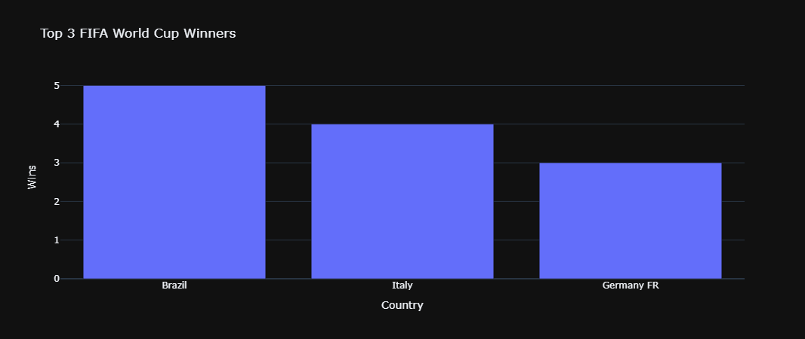
KEY FINDINGS
1. Top Performers
The analysis revealed the top-performing countries in FIFA World Cup history based on their tournament achievements. Brazil emerged as the most successful nation, boasting the highest number of World Cup wins. Argentina and Germany followed closely, securing multiple runner-up and third-place finishes. These findings highlight the dominance of certain nations in the world's most prestigious football tournament.

Slide 5
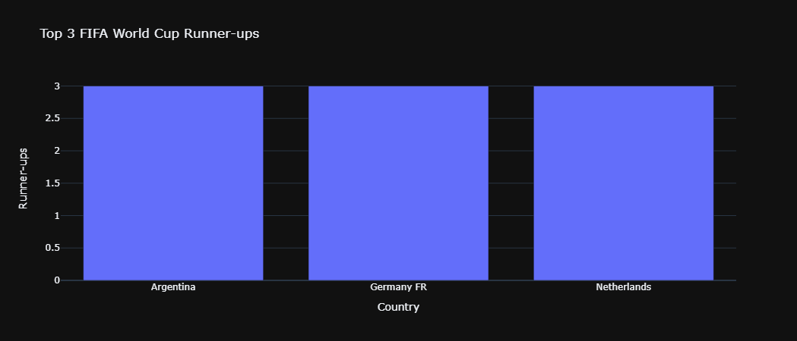
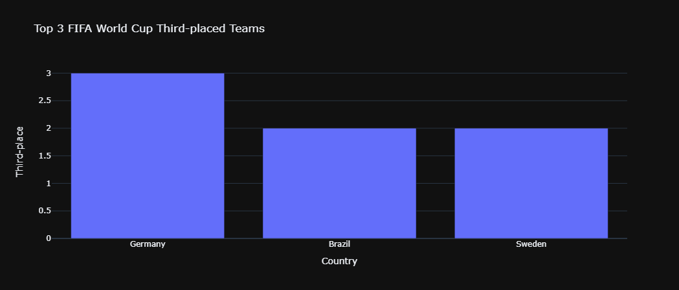

Slide 6
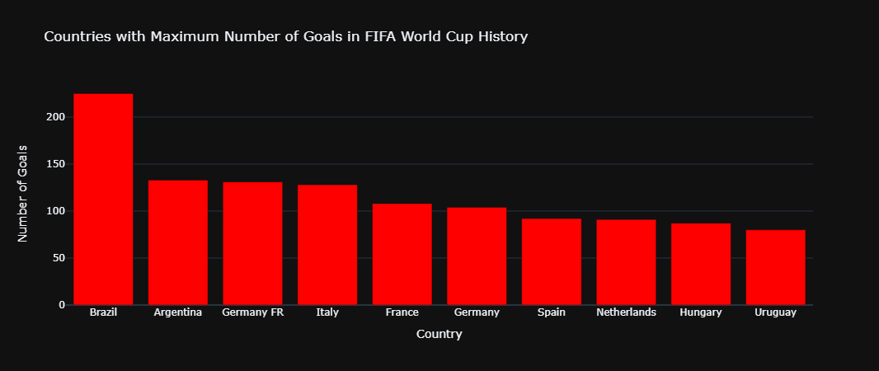
KEY FINDINGS
2. Goal Analysis
A comprehensive analysis of goals scored by different countries provided valuable insights into goal-scoring trends in FIFA World Cup history. Certain nations consistently featured among the top goal scorers, reflecting their offensive prowess and attacking strategies. The analysis also showcased the diversity of goal-scoring contributions from various countries, underscoring the global nature of football and the World Cup.

Slide 7
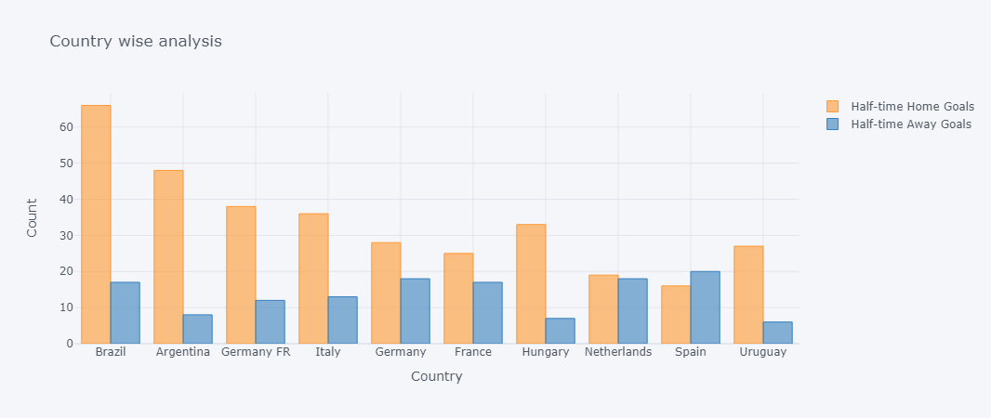
KEY FINDINGS
3. Half-time Analysis
Comparing half-time home goals and half-time away goals revealed interesting patterns in team performance during the first half of matches. By excluding draw matches from the analysis, a more accurate comparison of halftime performance dynamics was achieved. The findings shed light on the effectiveness of home and away teams in scoring goals during the early stages of matches, providing insights into tactical approaches and game strategies.

Slide 8
CODE
import pandas as pd
import numpy as np
import matplotlib.pyplot as plt
import seaborn as sns
%matplotlib inline
data1=pd.read_csv(r"C:\Users\khand\WorldCupMatches.csv")
data2=pd.read_csv(r"C:\Users\khand\WorldCupPlayers.csv")
data3=pd.read_csv(r"C:\Users\khand\WorldCups.csv")
data1.head()
data2.head()
data3.head()

Slide 9
import plotly as py
import cufflinks as cf
import plotly.express as px
from plotly.offline import iplot
py.offline.init_notebook_mode(connected=True)
cf.go_offline()
# Now collaborating for first three positions we are having
# Data preparation
data_winner = data3['Winner'].value_counts().reset_index()
data_winner.columns = ['Country', 'Wins']
data_runner_up = data3['Runners-Up'].value_counts().reset_index()
data_runner_up.columns = ['Country', 'Runner-ups']
data_third = data3['Third'].value_counts().reset_index()
data_third.columns = ['Country', 'Third-place']

Slide 10
# Creating bar charts
fig_winner = px.bar(data_winner.head(3), x='Country', y='Wins', title='Top 3 FIFA World Cup Winners')
fig_runner_up = px.bar(data_runner_up.head(3), x='Country', y='Runner-ups', title='Top 3 FIFA World Cup Runner-ups')
fig_third = px.bar(data_third.head(3), x='Country', y='Third-place', title='Top 3 FIFA World Cup Third-placed Teams')
# Displaying the plots
fig_winner.show()
fig_runner_up.show()
fig_third.show()
data_winner.head()
data_runner_up.head()
data_third.head()

Slide 11
teams = pd.concat([data_winner, data_runner_up, data_third], axis = 1)
teams
# Dealing with NaN values
teams.fillna(0,inplace=True)
teams=teams.astype(int)
#A complete despection of number of world cups won, first runner-up, and second runner-up positions by various participating teams
# Combine data for winners, runners-up, and third-placed teams
team_counts = pd.concat([data3['Winner'].value_counts(),
data3['Runners-Up'].value_counts(),
data3['Third'].value_counts()], axis=1, sort=True)
# Rename columns
team_counts.columns = ['Wins', 'Runner-ups', 'Third-place']

Slide 12
# Fill NaN values with zeros
team_counts.fillna(0, inplace=True)
# Calculate total number of appearances
team_counts['Total Appearances'] = team_counts.sum(axis=1)
# Sort teams based on total appearances
team_counts.sort_values(by='Total Appearances', ascending=False, inplace=True)
# Show the description
team_counts.iplot(kind='bar',yTitle='Count',title='Description of FIFA World Cup Performances by Various Teams',xTitle='Country’)
# Seperating data based on goals scored by teams
data_home=data1[['Home Team Name','Home Team Goals']].dropna()
data_away=data1[['Away Team Name','Away Team Goals']].dropna()

Slide 13
data_home.head()
data_away.head()
# Setting up the columns in both the tables
data_home.columns= ['Countries','Goals']
data_away.columns= ['Countries','Goals']
data_country_goals = pd.concat([data_home, data_away], ignore_index=True)
data_country_goals
# The above table do contain all the goals both home and away but con have different values for same countries, so...
data_final_country_goal=data_country_goals.groupby('Countries').sum()

Slide 14
# Arranging by number of goals
final_data=data_final_country_goal.sort_values(by='Goals',ascending=False)
final_data=final_data[:10]
final_data
#Countries with Maximum Number of Goals in FIFA World Cup History
import plotly.graph_objs as go
# Create a bar trace
bar_trace = go.Bar(
x=final_data.index, # Countries
y=final_data['Goals'], # Number of goals
marker=dict(color='red') # Bar color
)

Slide 15
# Create layout
layout = go.Layout(
title='Countries with Maximum Number of Goals in FIFA World Cup History',
xaxis=dict(title='Country'), # X-axis label
yaxis=dict(title='Number of Goals') # Y-axis label
)
# Create figure
fig = go.Figure(data=[bar_trace], layout=layout)
# Show the plot
fig.show()

Slide 16
# Comparing half time home goals scored and half time away goals scored
half_team_home=pd.DataFrame(data1[['Home Team Name','Half-time Home Goals']])
half_team_home = half_team_home.groupby('Home Team Name').sum()
half_team_home = half_team_home.sort_values(by='Half-time Home Goals',ascending=False)
half_team_home
half_team_away=pd.DataFrame(data1[['Away Team Name','Half-time Away Goals']])
half_team_away = half_team_away.groupby('Away Team Name').sum()
half_team_away = half_team_away.sort_values(by='Half-time Away Goals',ascending=False)
half_team_away
# Concatinating both the tables on team name
total = pd.concat([half_team_home, half_team_away], axis = 1)
total

Slide 17
# Creating total goals columns to order the table based on total number of goals scored by a team
total['total_goals'] = total['Half-time Home Goals'] + total['Half-time Away Goals']
total = total.sort_values(by= 'total_goals',ascending=False)
total=total[:10]
total
# We don't require total_goals anymore, so...
total.pop('total_goals')
total
#Brazil has again scored a majority of total goals playing as home team whereas spain scored more goals playing as away country rather than home country
total.iplot(kind='bar',yTitle='Count',title='Country wise analysis',xTitle='Country')

Slide 18
# We didn't considered draw matches here because in many cells we had NaN values given which corresponded to 0 values and could
# had made our pie chart biased.
def winner(data1):
if data1['Home Team Goals'] > data1['Away Team Goals']:
return 'Home team won'
elif data1['Home Team Goals'] < data1['Away Team Goals']:
return 'Away Team won'
data1['winner']=data1.apply(lambda x:winner(x),axis=1)
data1['winner'].value_counts()

Slide 19
# Filter out draw matches where home team goals and away team goals are both 0
non_draw_matches = data1[(data1['Half-time Home Goals'] != 0) | (data1['Half-time Away Goals'] != 0)]
# Calculate the total number of half-time home goals scored
total_home_goals = non_draw_matches['Half-time Home Goals'].sum()
# Calculate the total number of half-time away goals scored
total_away_goals = non_draw_matches['Half-time Away Goals'].sum()
# Create a bar trace for half-time home goals
home_trace = go.Bar(
x=['Half-time Home Goals'],
y=[total_home_goals],
name='Half-time Home Goals',
marker=dict(color='blue')
)

Slide 20
# Create a bar trace for half-time away goals
away_trace = go.Bar(
x=['Half-time Away Goals'],
y=[total_away_goals],
name='Half-time Away Goals',
marker=dict(color='green')
)
# Create layout
layout = go.Layout(
title='Comparison of Half-time Home Goals and Half-time Away Goals (Excluding Draw Matches)',
yaxis=dict(title='Total Goals')
)
# Create figure
fig = go.Figure(data=[home_trace, away_trace], layout=layout)

Slide 21
# Show the plot
fig.show()
data2['Team Initials'].unique()
data_nat = pd.DataFrame(data2[['Team Initials','Player Name']])
data_nat.head()
d2 = pd.DataFrame(data_nat['Team Initials'].value_counts())
d2
d2.iplot(kind='bar',yTitle='No of players',title='Country codes vs number of players played',colors='blue',xTitle='Country code')

Slide 22
#Matches Per Year
matches_per_year = data1['Year'].value_counts().sort_index()
plt.figure(figsize=(10, 6))
matches_per_year.plot(kind='bar', color='skyblue')
plt.title('Number of Matches per Year')
plt.xlabel('Year')
plt.ylabel('Number of Matches')
plt.xticks(rotation=45)
plt.grid(axis='y', linestyle='--', alpha=0.7)
plt.tight_layout()
plt.savefig('matches_per_year.png')
plt.show()

Slide 23
### Distribution of Cup Winners
cup_winners_distribution = data3['Winner'].value_counts().head(10)
plt.figure(figsize=(10, 6))
sns.barplot(x=cup_winners_distribution.values, y=cup_winners_distribution.index, palette='viridis')
plt.title('Distribution of Cup Winners')
plt.xlabel('Number of Wins')
plt.ylabel('Country')
plt.tight_layout()
plt.savefig('cup_winners_distribution.png')
plt.show()

Slide 24
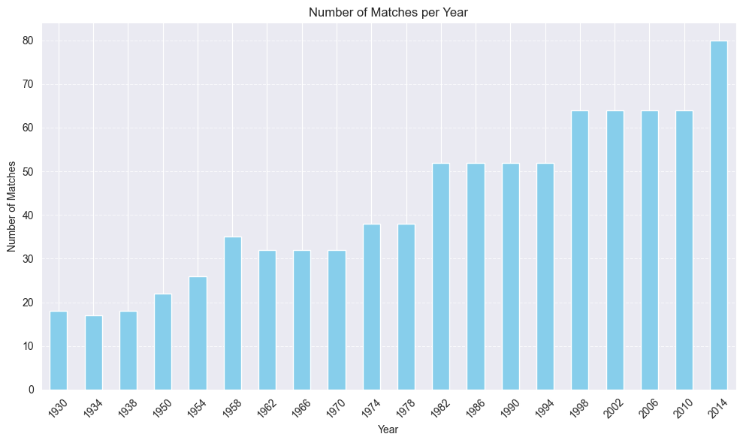
VISUALIZATION

Slide 25
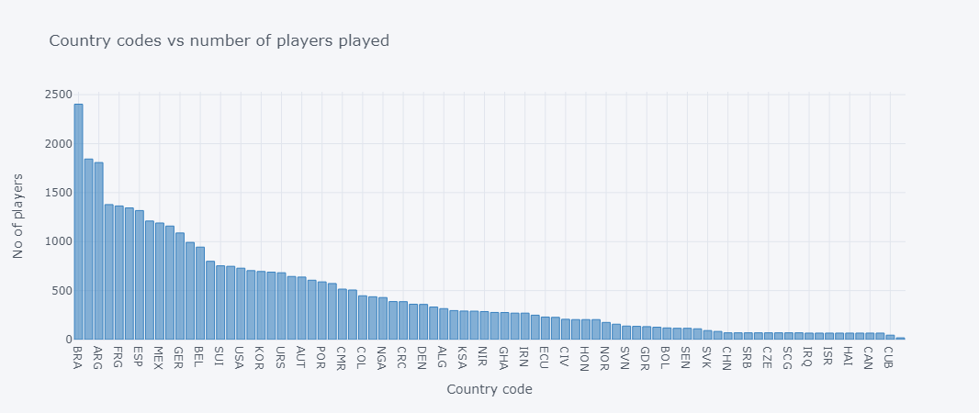

Slide 26
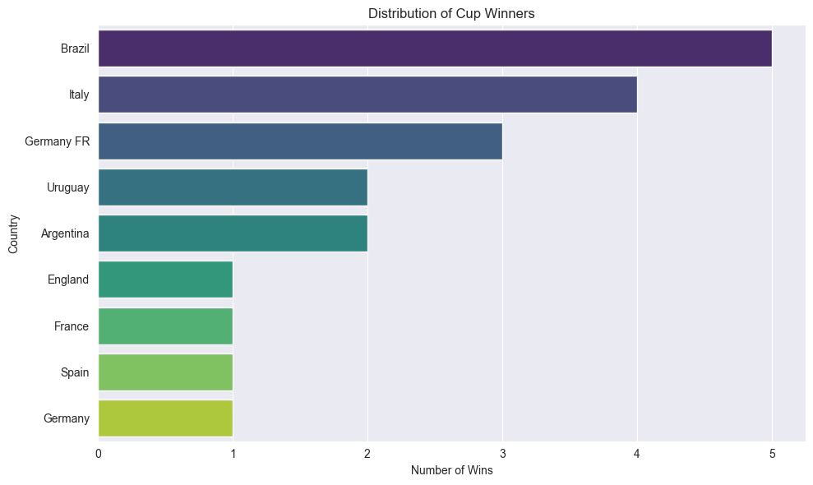

Slide 27
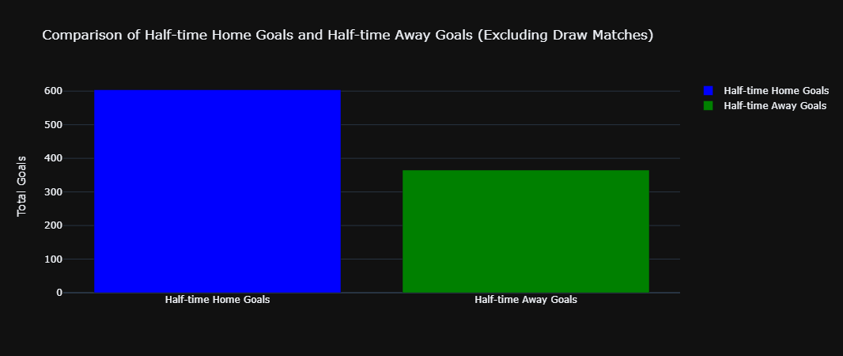

Slide 28
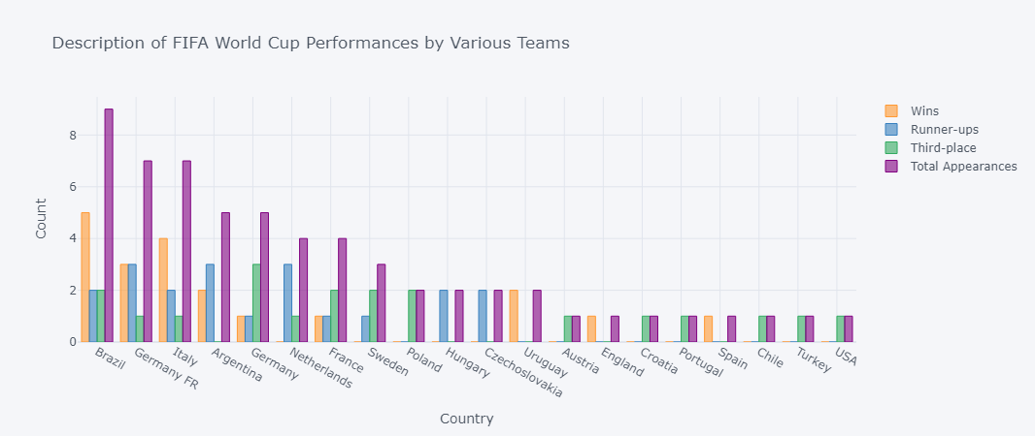

Slide 29
CONCLUSION
The FIFA World Cup Analysis project has provided valuable insights into the dynamics of one of the most celebrated sporting events in the world. By examining matches, players, and cups across different editions of the tournament, we have uncovered trends, patterns, and significant moments that shape the history and legacy of the FIFA World Cup.

Slide 30
THANK YOU!!

